Slide 1

Amazon Sales Data Analysis
By: Thejaswini K Lamani

Slide 2
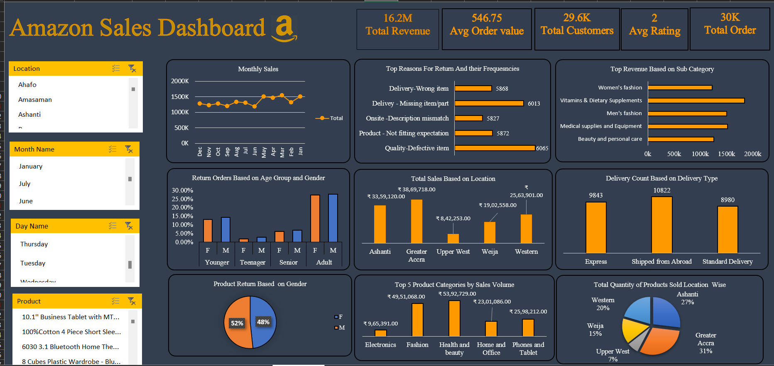

Slide 3
Steps for conducting Data Analysis
Data Gathering: Clearly outline the goals and what you aim to achieve with the data analysis.
Data Cleaning: Handle missing values, remove duplicates, and correct errors to ensure data quality.
Creating Dashboards and Reports : Identify key performance indicators and metrics that align with your objectives.

Slide 4
Introduction
This presentation provides a comprehensive analysis of Amazon's sales data, focusing on key metrics such as monthly sales, year-wise sales, reasons for product returns, revenue distribution by sub-category, and return orders based on gender. The purpose of this analysis is to uncover valuable insights that can inform strategic decisions and improve business performance.

Slide 5

Objective
The main objectives of this analysis are:
To identify sales trends and patterns on a monthly and yearly basis.
To understand the top reasons for product returns and their frequencies.
To analyze revenue distribution across different sub-categories.
To examine return orders based on gender and identify any significant patterns.
To provide actionable recommendations based on the insights derived from the data.

Slide 6

Sales Data And Statistics
16.2M Total Revenue
30K Total Order
29.6K Total Customers
546.75 Avg Order value

Slide 7
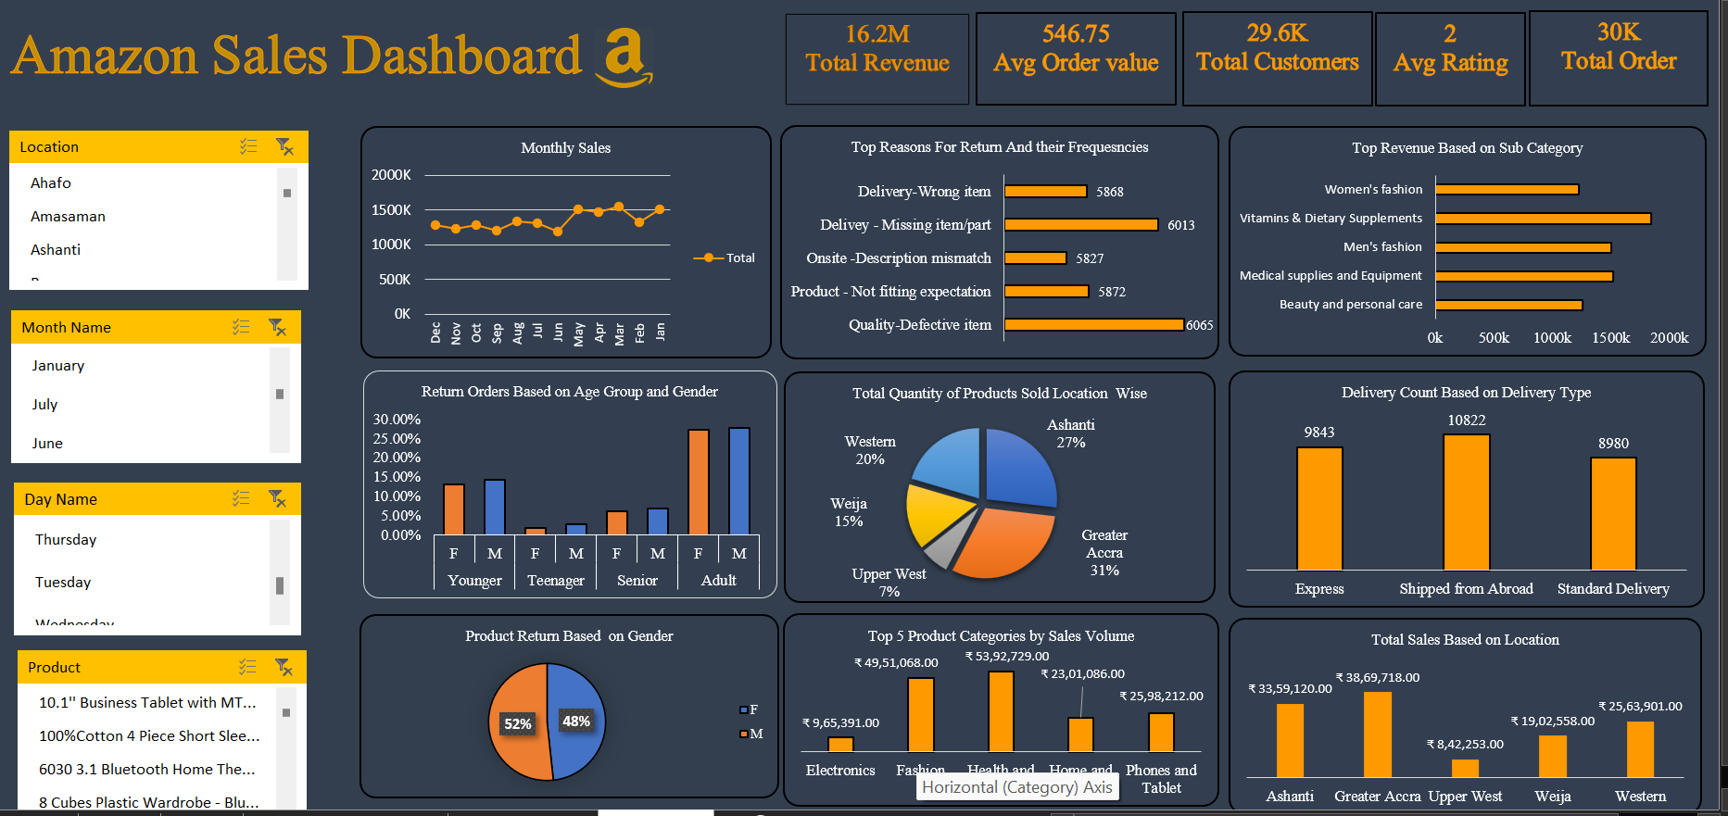

Slide 8
Sales Data And Statistics
Year Sales Insights
The bar chart displays year-wise total revenue from 2015 to 2020.
Revenue remains relatively stable from 2015 to 2019, averaging around 2.5 million.
However, in 2020, there is a significant increase in total revenue, jumping to approximately 3.6 million, indicating a notable growth that year.

Slide 9
Sales Data And Statistics
Insights on the Top Reasons for Returns
Quality Issues are the Leading Cause of Returns: The most frequent reason for product returns is related to quality, with "Quality-Defective item" being the highest at 6065 instances. This indicates that improving product quality could significantly reduce return rates.
Delivery Issues are Common: "Delivery - Missing item/part" and "Delivery-Wrong item" are also prominent reasons for returns, with 6013 and 5868 instances respectively. Enhancing the accuracy and completeness of deliveries could mitigate these returns.

Slide 10
Sales Data And Statistics
Monthly Sales Insights
The line chart shows monthly sales with fluctuations between 1.2 million and 1.6 million units, peaking in May and dipping in August.
Noticeable increases occur from July to August and October to November. Sales in January and December are consistent around 1.3 million units, indicating stable demand during these months.

Slide 11
Sales Data And Statistics
Insights of Top Revenue Based on Sub Category
Vitamins & Dietary Supplements lead in revenue, surpassing 1.8 million, followed by Beauty and Personal Care at nearly 1.6 million, showing high consumer interest in health and grooming products.
Medical Supplies and Equipment, Women's Fashion, and Men's Fashion each generate over 1 million in revenue, highlighting strong markets in medical needs and apparel.

Slide 12
Sales Data And Statistics
Insights About Return Orders Based on Age Group:
The chart shows that adults have the highest return rates, with both genders returning over 25% of orders.
Teenagers have the lowest return rates, barely over 5%. Younger and senior age groups have moderate return rates, with males slightly higher among younger and females slightly higher among seniors.

Slide 13
Sales Data And Statistics
Insights on Total Sales Based on Location
The bar chart indicates that Greater Accra has the highest total sales among the locations, followed by Ashanti and Western regions.
Weija and Upper West have significantly lower sales, with Upper West having the least.
This suggests that Greater Accra is a major sales hub, while Upper West lags behind in sales volume.

Slide 14
Sales Data And Statistics
Insights of Top 5 Product Category:
Health and Beauty: $5,392,729 in sales, leading the market.
Fashion: $4,951,068 in sales, showing strong demand.
Phones and Tablets: $2,598,212 in sales, reflecting mobile technology's significance.
Home and Office products: $2,301,086 in sales, driven by remote work trends.
Electronics: $965,391 in sales, notable despite being the lowest among the top five.

Slide 15
Sales Data And Statistics
Insights of Distribution of Orders By Month:
The chart shows the distribution of orders by month over a year.
Orders peaked in March and April, followed by a decline through June.
The volume of orders remained relatively stable from July to December, with a slight increase in December.

Slide 16
Sales Data And Statistics
Insights of Products Returns Based On Gender:
The pie chart shows that product returns are almost evenly distributed between genders, with females accounting for 48% and males 52% of the returns.
This indicates a relatively balanced return behavior across genders.

Slide 17
Question And Answer Session
Q1 What is the total sales revenue?
Ans Total Sales Revenue Is 16.2Millions
Q2 What is the average shipping fee?
Ans The average Shipping Fee is 11.492
Q3. What is the average unit price of products?
Ans Average unit price of Products is Rs.100
Q4. What is the distribution of customer gender?
Ans The Distribution Of Customers are there are 14317 Female customers and 15328 Male Customers

Slide 18
Q5. Which product category has the highest number of Sales?
Ans Health and Beauty has Highest number of Sales
Q6. Which product subcategory is the most popular?
Ans Vitamins and diet Supplements are most Popular
Q7. What is the total quantity of products sold?
Ans Total Products Sold 122650
Q8 What is the most common delivery type?
Ans Most Common Delivery Type is Shipped From Abroad with a count of 10822
Q9. What are the most common reasons for returns?
Ans Most Common Reason For Returns Quality with Defective

Slide 19
Q10. Analyzing Product Returns Based on Age Group
Answer: Adults aged more than 30 return products more frequently compared to other age groups.
Q11 What could be the potential reasons for the sudden increase in revenue in 2020?
Answer: Possible reasons could include a successful product launch, increased marketing efforts, expansion into new markets, or external factors like changes in consumer behavior due to the COVID-19 pandemic.

Slide 20
Thank You

